Slide 1

Mobile Application Development, Fall 2021 Introduction to State Management Part 3

Slide 2
Today’s Agenda
Today’s Plan
The TextInput Component
Text and State
Conditional JSX

Slide 3
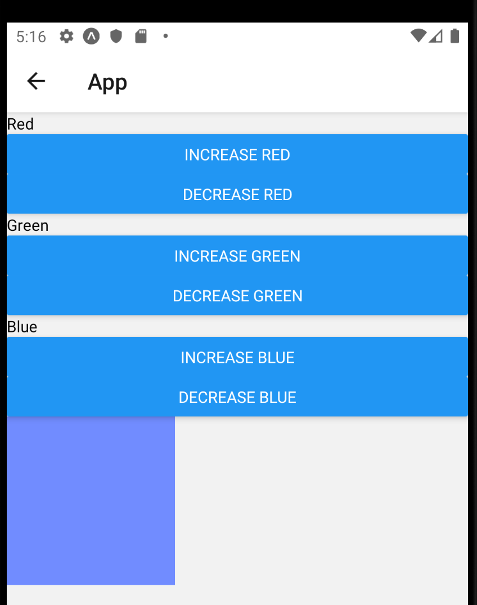
Today’s Plan
We’ve been working on this guy for a bit now!
This humble app has taught us about two hooks:
The useState hook
The useReducer hook.

Slide 4

Today’s Plan
Enter Your Name:
Today, we leave that particular app behind!
And return to…
THIS guy!
Seen ever-so-briefly when we were first learning about state!
Your name is:

Slide 5
Today’s Plan
Enter Your Name:
Benjami
As you may recall: the idea behind this one is that as you type in the name, character by character up top…
It starts showing up character by character down below.
Your name is:
Benjami

Slide 6
Today’s Plan
Enter Your Name:
Benjami
Once again, this is a pretty simple app!
And hopefully, given how all of you are state experts…
I would imagine you all have a pretty good feel for how you might get started on this!
But as it turns out: text in react native is a little tricky.
Your name is:
Benjami

Slide 7
Today’s Plan
Enter Your Name:
Benjami
Let’s do the same thing we’ve been doing when we make a new screen!
1.) Create a new file for the screen component.
2.) Import that screen into App.js and add it to the stack navigator.
3.) Add a new menu option on our home screen to get to this new one.
Your name is:
Benjami

Slide 8
Today’s Plan
Enter Your Name:
Benjami
Let’s do the same thing we’ve been doing when we make a new screen!
1.) Create a new file for the screen component (We’ll call it TextScreen.js).
2.) Import that screen into App.js and add it to the stack navigator.
3.) Add a new menu option on our home screen to get to this new one.
Your name is:
Benjami

Slide 9
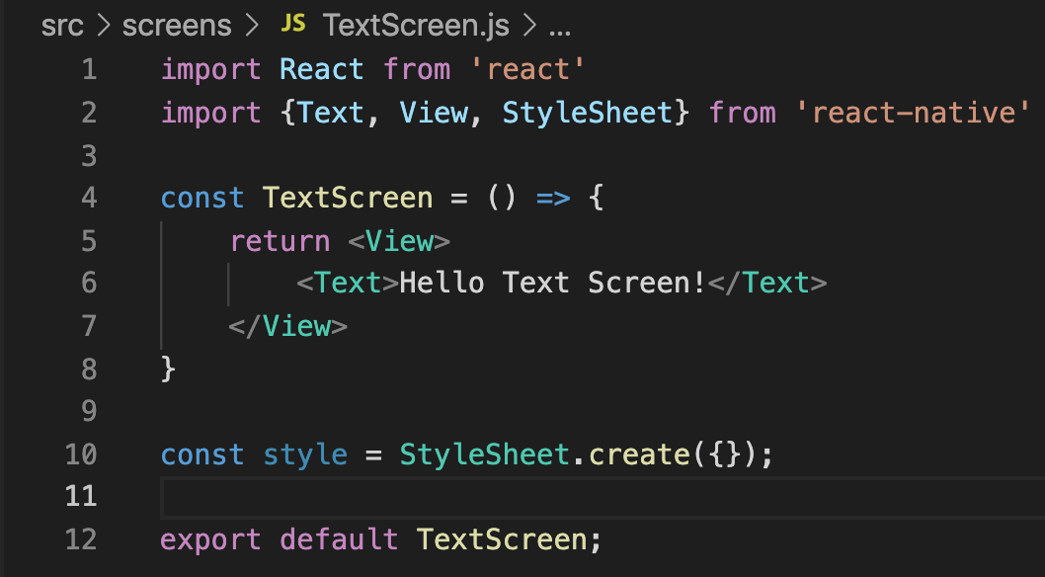
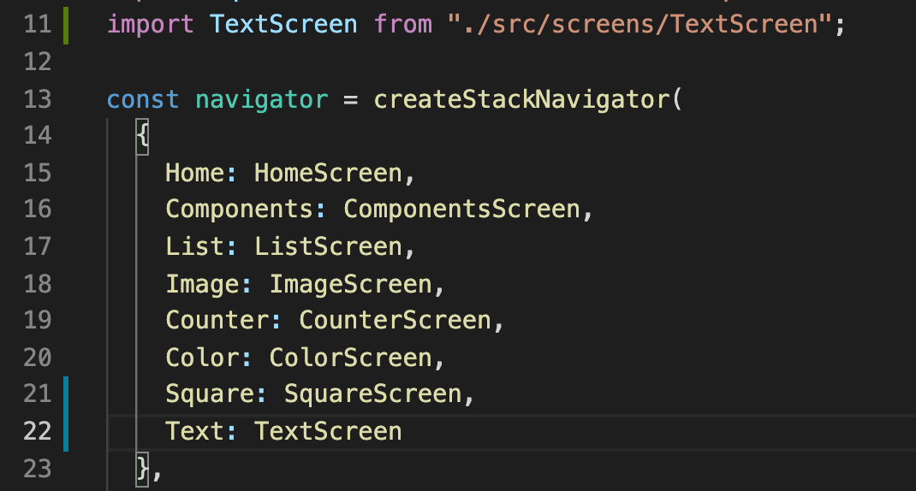
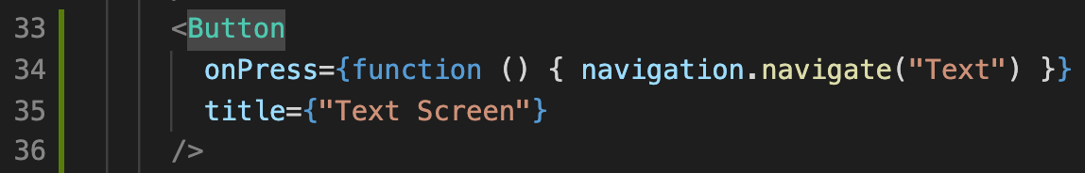
Today’s Plan
By this point we could do this in our sleep!
TextScreen.js
HomeScreen.js
App.js

Slide 10
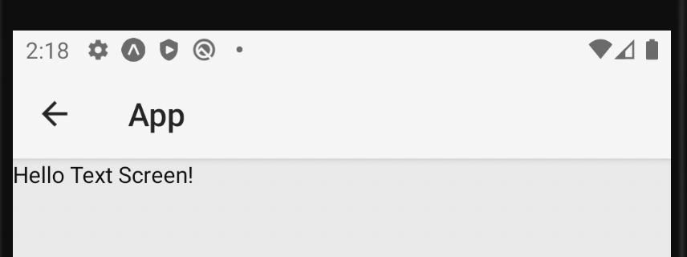
Today’s Plan
Giving us yet another blank canvas to create glorious react-native art upon!
Let’s work with Text!

Slide 11
Today’s Agenda
Today’s Plan
The TextInput Component
Text and State
Conditional JSX

Slide 12
The TextInput Component
Enter Your Name:
As is so often the case, we still have a bit of a gap between our mockup and our current app.
One thing to note: we’ve never actually *gotten* text input before!
Your name is:

Slide 13
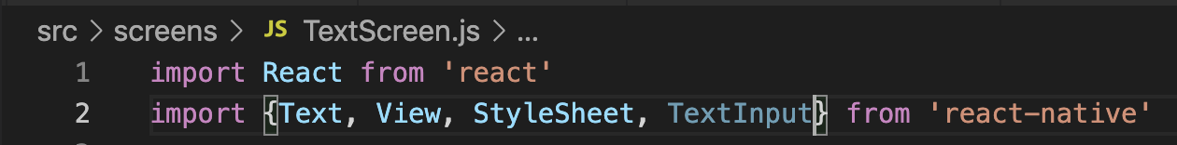
The TextInput Component
In order to get text input, we’ll need to import another react native primitive component.
Conveniently enough, called TextInput
TextScreen.js

Slide 14
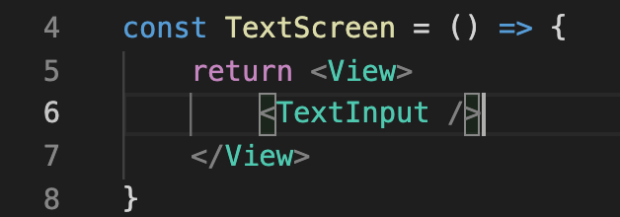
The TextInput Component
And then after we’ve imported it, we can use it in the same way we’ve used other components!
Let’s just replace the Text component we had before with this new TextInput component.
TextScreen.js

Slide 15
The TextInput Component
TextScreen.js
Now, you’re probably thinking…
“Wait, surely I must need props and stuff right? It can’t possibly be that easy, can it?”
And, er, well, you’re right. It isn’t going to be quite this easy. But let’s see what the above buys us.

Slide 16
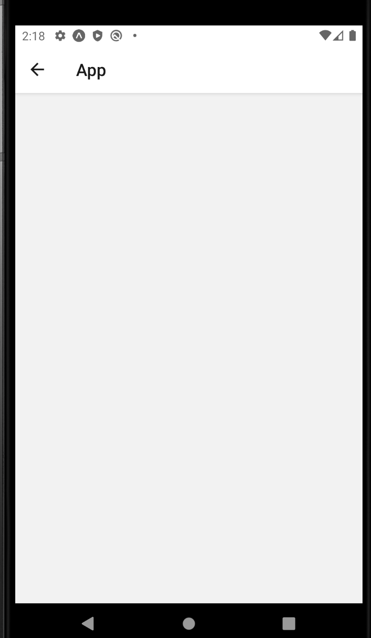
The TextInput Component
If you were to open up your app, you would see something that looks like this, more likely than not.
That is, something that looks pretty empty.
However, it only LOOKS empty!

Slide 17
The TextInput Component
Nothing is displaying, BUT our TextInput component *is there!*
Right along the top!
If you very carefully tried clicking on it…

Slide 18
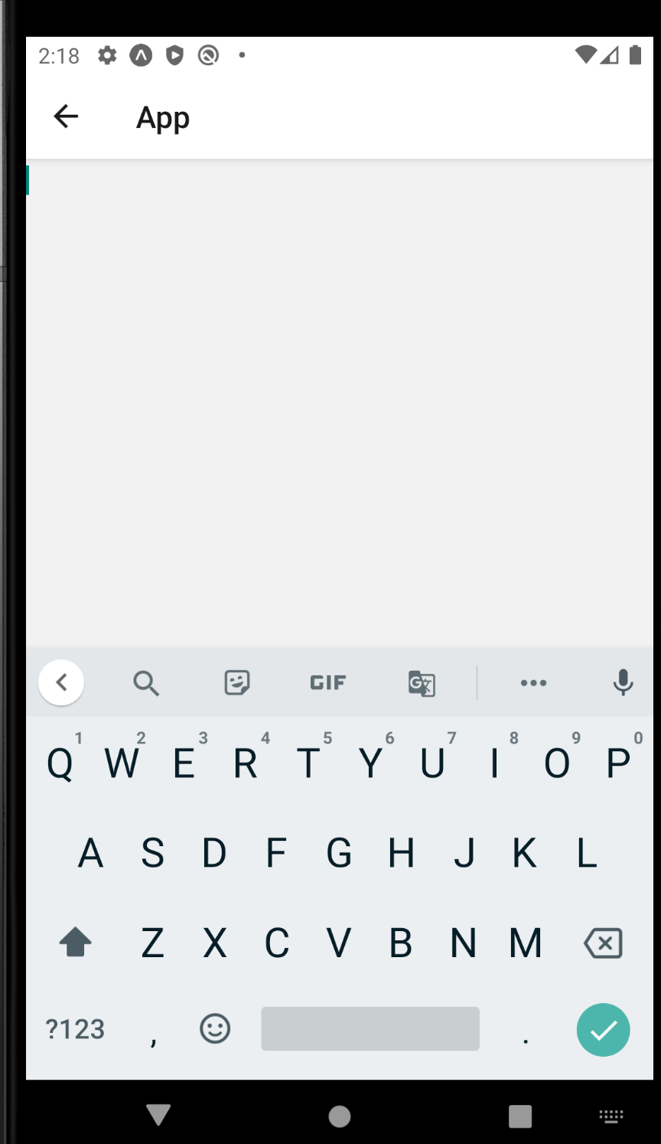



The TextInput Component
You’d see the behavior that you would expect from an opportunity to enter text!
A little blinking cursor will display (hard to see on this screenshot, I know!)
And the keyboard for actually typing input just pops up for us as well!

Slide 19
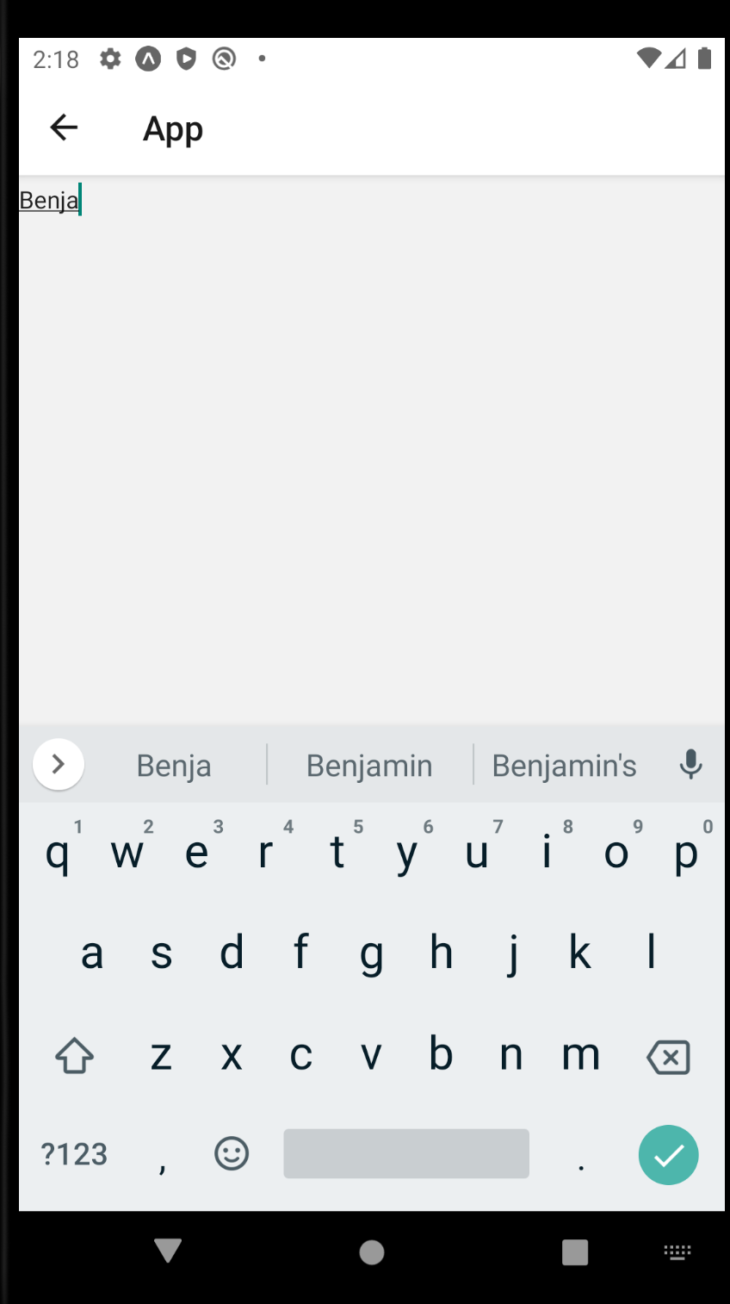
The TextInput Component
And stuff that we type will then begin to fill in as you would expect.
So y’know, this is pretty good! But it certainly was a bummer that it was essentially invisible, huh?

Slide 20
The TextInput Component
The upshot is that the TextInput component comes with *no* styling associated with it.
Other than like, a small default height.
Hence, why it is pretty hard to see.
The onus falls to us to do the styling!
And let’s do it using our stylesheet!
We haven’t touched that in a while!

Slide 21
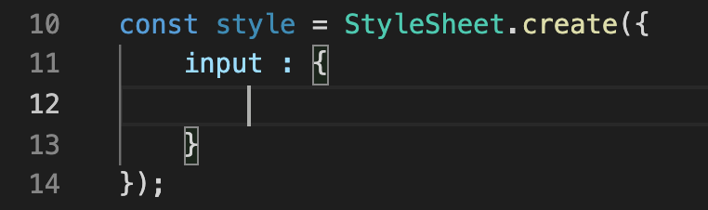
The TextInput Component
TextScreen.js
Remember how these StyleSheets work!
Here, style is a variable that will store our StyleSheet
Could call this anything you want.
StyleSheet.create is a function that produces a style sheet!

Slide 22
The TextInput Component
TextScreen.js
StyleSheet.create takes in a JavaScript object as input.

Slide 23
The TextInput Component
TextScreen.js
And that object can have as many properties as we want, with each one of those properties being it’s OWN Javascript object.
Right now we only have one of those properties, called input.
We could call this anything we wanted!
But calling it input since we’ll plan on applying it to our TextInput property.
The object input holds is going to be full of styling information.
That styling information you *don’t* get to call whatever you want.
Very specific ways that react native components can be styled.

Slide 24
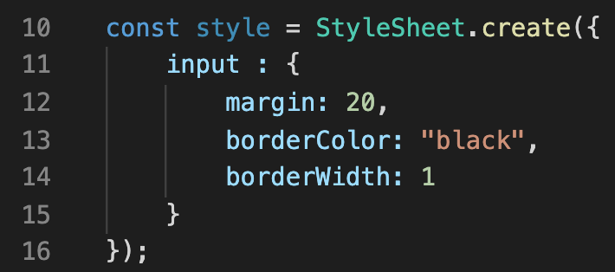
The TextInput Component
We’re going to chat more about all of the different styling options we’ll have available to us very soon!
It’s what the next lecture is planned to be about ☺
But for now, let’ add in some margin, a borderColor, and a borderWidth.
TextScreen.js

Slide 25
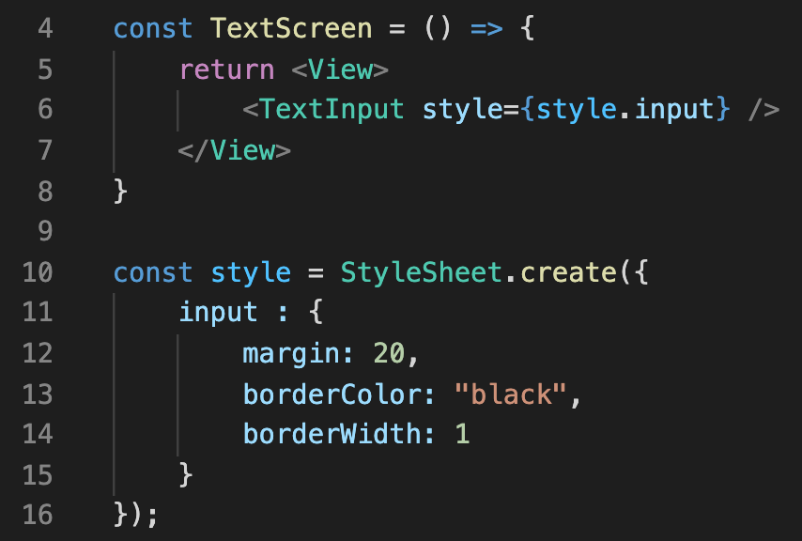
The TextInput Component
And of course, don’t forget to actually apply the style to the TextInput!
We do so by, again, handing that style object down to the style prop of our component.
TextScreen.js

Slide 26
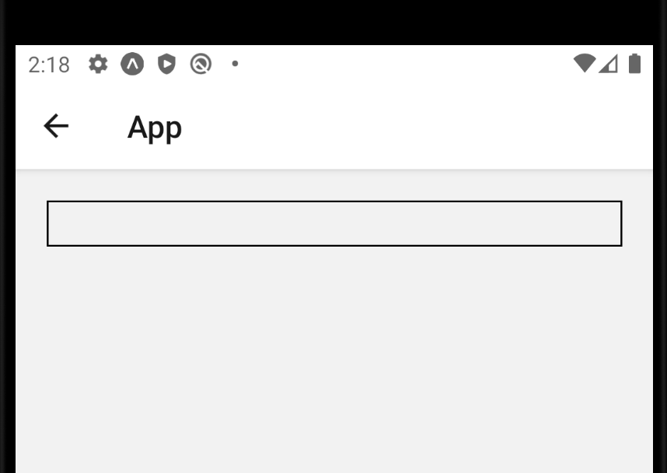
The TextInput Component
In so doing, our TextInput is revealed!
We have now a TextInput with a thin black line as a border.
And look how it isn’t bumping up against the edges of the screen!
That’s the power of margins!

Slide 27
The TextInput Component
So, yeah.
Basically every time you ever have a TextInput component, you’ll have to/want to add some styling to it.
But that’s not the only thing you’ll want to do!

Slide 28
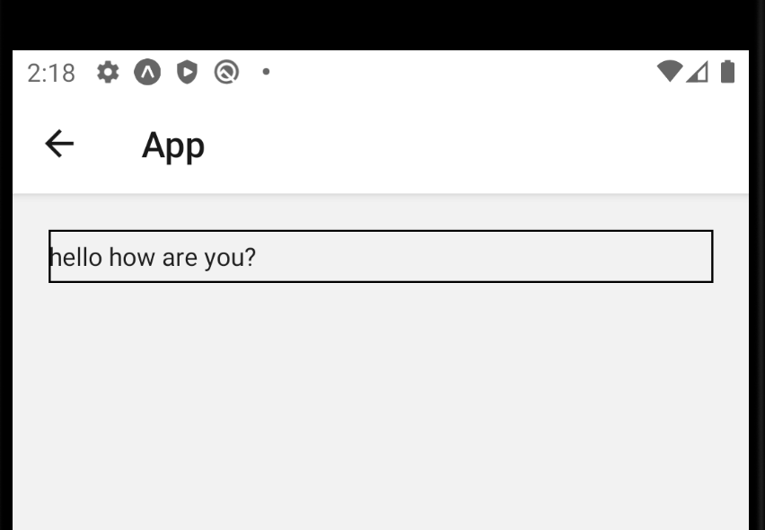
The TextInput Component
Thus far, basically everything we’ve done has the same impact on both Android and iOS devices.
This is the first time where there is a slight departure between their default functionality!
On Android, typically when you type text in, it enters it the way that you type it.

Slide 29
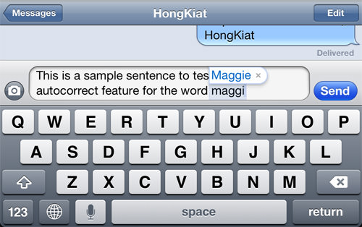


The TextInput Component
But in the name of trying to help you out, iOS will sometimes do some stuff for you!
It will usually try to automatically capitalize the first letter of the first word.
And it will suggest autocorrect.

Slide 30
The TextInput Component
Although in certain contexts, like text messaging, that’s probably all helpful…
In other contexts, like entering in a password, it changing your text without your permission can be *really* frustrating.

Slide 31
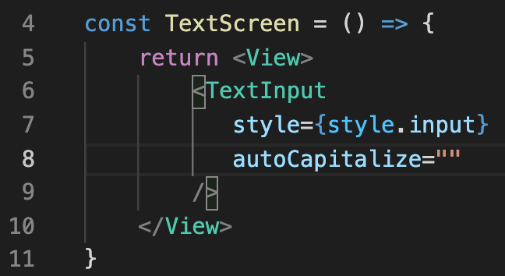
The TextInput Component
Thankfully, there are some props associated with TextInput that can give us that finer grained control
The first is autoCapitalize
TextScreen.js

Slide 32
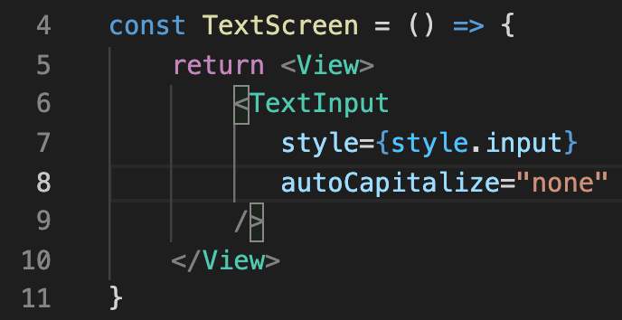
The TextInput Component
The value of “none” is often what you’ll want.
It turns off automatically capitalizing things.
But you might wonder… why a string? Why not something like:
autoCapitalize={false}
TextScreen.js

Slide 33
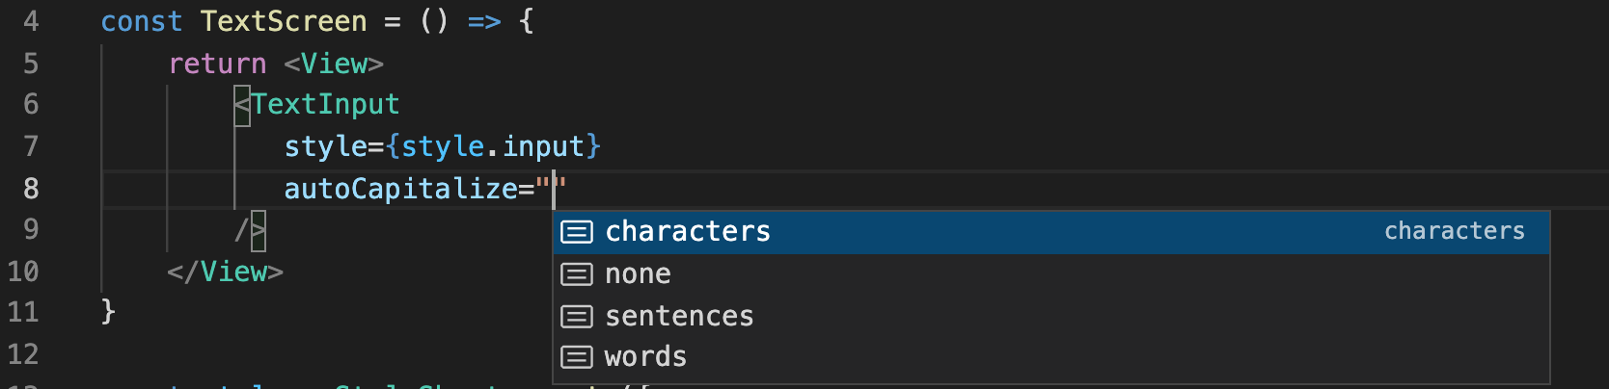
Working With Text
TextScreen.js
The answer is because there’s actually a few choices here!
You could have it auto capitalize sentences (the default).
But you could also have it auto capitalize words!
i.e., every time you hit space, it wants to capitalize again!
Or characters!
i.e., it basically tries to capitalize everything!

Slide 34
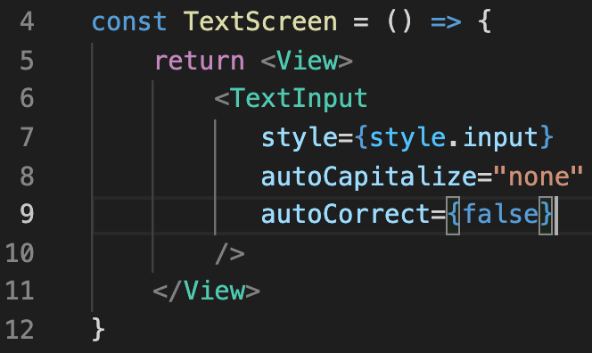
The TextInput Component
We’ll stick with “none” for now.
The other prop we’ll want to adjust is autoCorrect.
This one *does* take in a Boolean value!
By default, it will be set to true.
But we can set it to false easily enough!
TextScreen.js

Slide 35
The TextInput Component
These are often the settings you’ll want your TextInput to have!
If you are ever handling user names, or passwords, or emails…
i.e., things that probably have inconsistent spelling and capitalization…
You don’t’ want the phone changing things from what the user typed in!
TextScreen.js

Slide 36
The TextInput Component
OK! We’ve just made our first TextInput component!
Delightful!
Now, let’s explore some of the intricacies of the relationship between text and state.

Slide 37
Today’s Agenda
Today’s Plan
The TextInput Component
Text and State
Conditional JSX

Slide 38
Text and State
I’m going to warn you right off the bat: we’ll have to treat this a little differently than how we’ve worked with state before.
But, ah, pretend for a second you didn’t know that!
How do think you would have to/want to use state here?

Slide 39
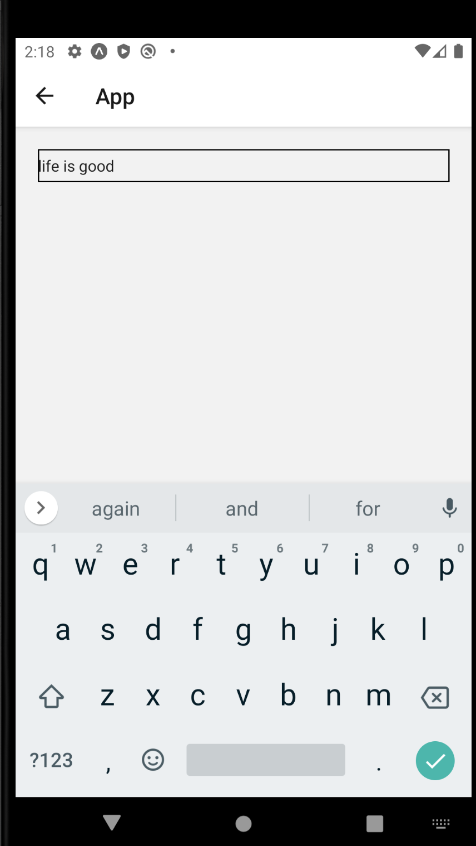
Text and State
Instead of me predicting what I think you might have guessed… let me show you some considerations that we need to have.
So, right now, our TextInput component let’s us type in letters, and they show up!
So it seems like all is well, yeah?

Slide 40
Text and State
TextScreen
But let’s quickly visualize this parent-child relationship of this app.
Only two components, so it is pretty easy!
TextScreen is the parent of TextInput
But the text that we are writing is currently part of the TextInput component.
i.e., it is part of the child component!
TextInput
{currentText:
“life is good”}

Slide 41
Text and State
TextScreen
You may recall that the previous advice that we gave was “define state in the upper-most parent”
But here, we didn’t *really* define any state. We’re just taking advantage of the built-in properties of TextInput to store some text.
And again, that’s fine for now…
TextInput
{currentText:
“life is good”}

Slide 42
Text and State
TextScreen
But eventually, we want whatever text is in that TextInput field to ALSO show up in another child component of TextScreen.
And *that’s* something we haven’t had to contend with before!
TextInput
Text
{currentText:
“life is good”}
{currentText:
“”}

Slide 43
Text and State
TextScreen
We could have TextScreen just kind of… reach into its child component and grab the data that is in there…
But this is typically frowned upon!
We like the data flowing down from parent to child, not vice versa.
TextInput
Text
{currentText:
“life is good”}
{currentText:
“”}

Slide 44
Text and State
TextScreen
{currentText: “hi”}
So, ah, the solution is basically to just do exactly that!
We’ll declare a piece of state in the parent component that will keep track of our current state!
TextInput

Slide 45
Text and State
TextScreen
{currentText: “hi”}
And we’ll pass it down to our TextInput using a special prop called value.
It expects a string.
The value prop basically says “hey –make the contents of this TextInput the string that is stored in value.
{value: currentText}
TextInput

Slide 46
Text and State
TextScreen
{currentText: “hi”}
TextInput also has another prop called onChangeText.
This will be another call back function –
onChangeText takes in a function
That function will be called whenever the text of the TextInput changes!
More on this in just a second.
{value: currentText,
onChangeText: () => {} }
TextInput

Slide 47
Text and State
TextScreen
{currentText: “hi”}
First, let’s just quickly verify how the value prop works!
{value: currentText,
onChangeText: () => {} }
TextInput

Slide 48
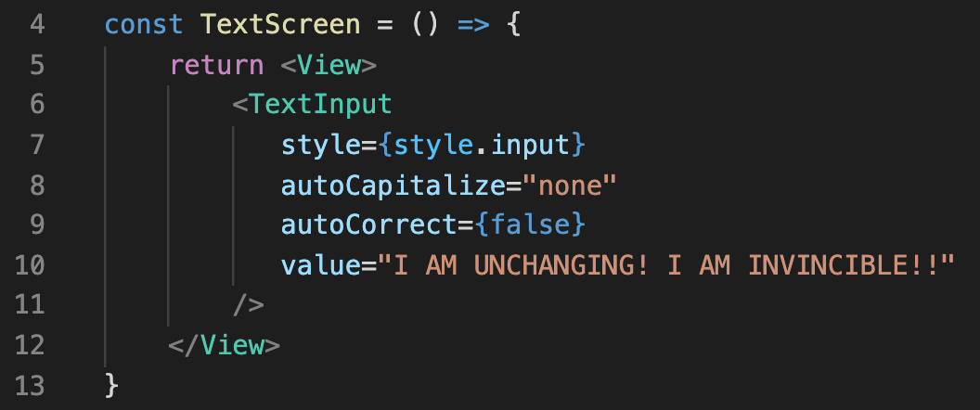
Text and State
We’ve updated our TextInput to have a value prop.
We’ve given it a very dramatic string.

Slide 49
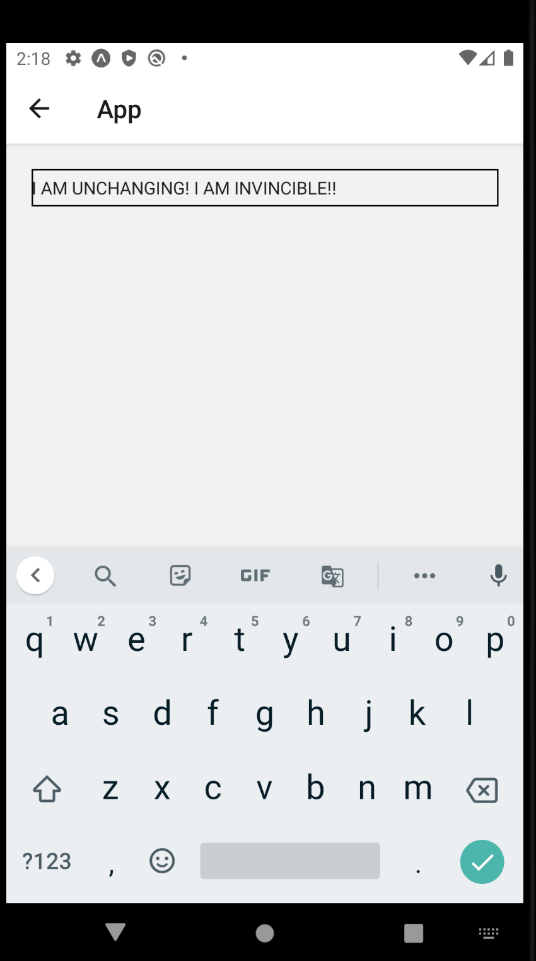
Text and State
And because of that, that string will show up in the box.
And true to the text – it is unchanging.
Even if you typed in the keyboard, it wouldn’t stick!
Because the string in the value prop has been hardcoded!

Slide 50
Text and State
TextScreen
{currentText: “hi”}
So jumping back to here…
That callback function we’ll store inside of onChangeText is going to get called any time someone tries to change the text in our TextInput.
i.e., anytime someone tries to type something.
{value: currentText,
onChangeText: () => {} }
TextInput

Slide 51
Text and State
TextScreen
{currentText: “hi”}
So then, another mind’s eye programming moment…
We now have a piece of state declared in TextScreen
Let’s say done using “useState” as opposed to ”useReducer”
And we now know about these two props.
What do we do make it so that our text input actually updates its contents?
{value: currentText,
onChangeText: () => {} }
TextInput

Slide 52
Text and State
Let’s chat about it!
First, we’ll need to import the useState hook from the react library.

Slide 53

Text and State
And then we’ll use it in the way that we’ve done several times by this point!
We recall/see…
useState is our hook we are calling.
It takes as input the default/starting value for our piece of state.
Here, set to the empty string.
It returns an array.
We store the first element of that array in a variable called name, here.
This is for *reading* purposes only. Not changing values.
We store the second element in a variable called setName.
This is our *setter function* -- this is how we will update the state.

Slide 54
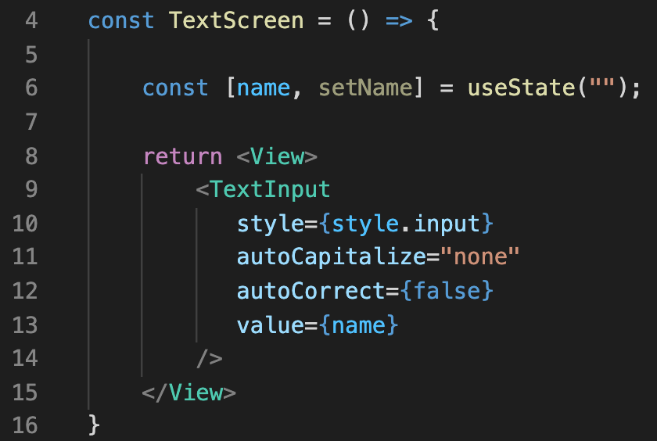
Text and State
We can then have this piece of state be what we pass in to value!
Might feel weird to have the parent (TextScreen) tell the child (TextInput) what the value should be.
But again, this will allow the name data to be passed down to other child components as well!

Slide 55

Text and State
Of course, at this exact moment, we’ve just traded one permament string for another.
Because name’s default value is “”, and there’s no way for it to ever be changed, our screen will just have a perpetually empty TextInput

Slide 56
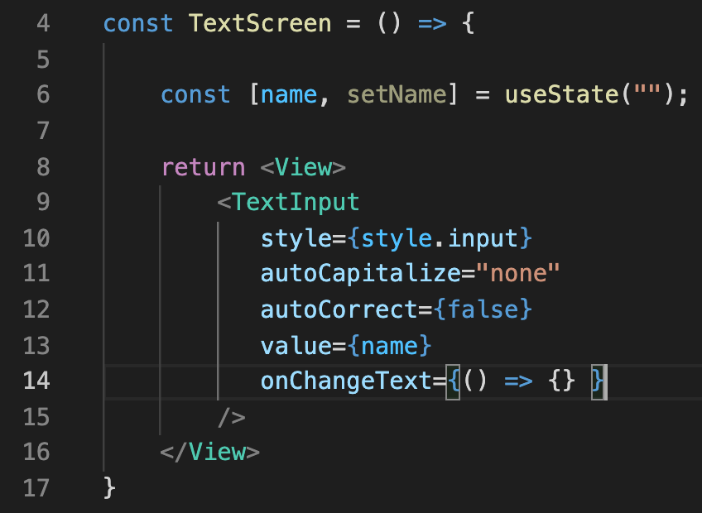
Text and State
The solution, as previously alluded:
Add another new prop to TextInput: the onChangeText.
This will be another callback function that will be called every time the text of the TextInput changes.

Slide 57
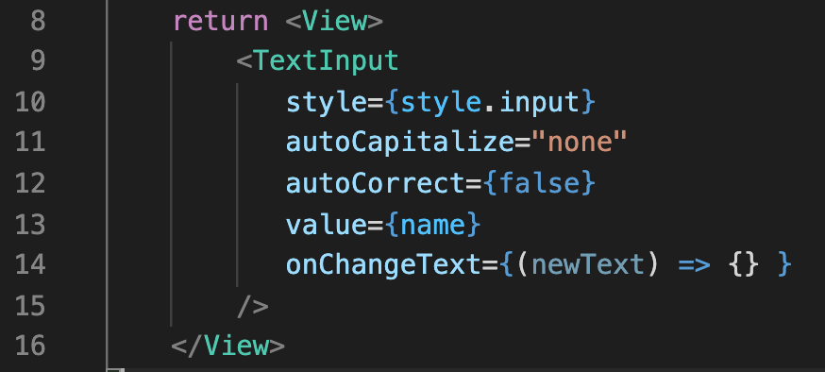
Text and State
It takes in one parameter: A string that holds all of the text that is currently in the TextInput.
You can call the parameter anything you want!

Slide 58
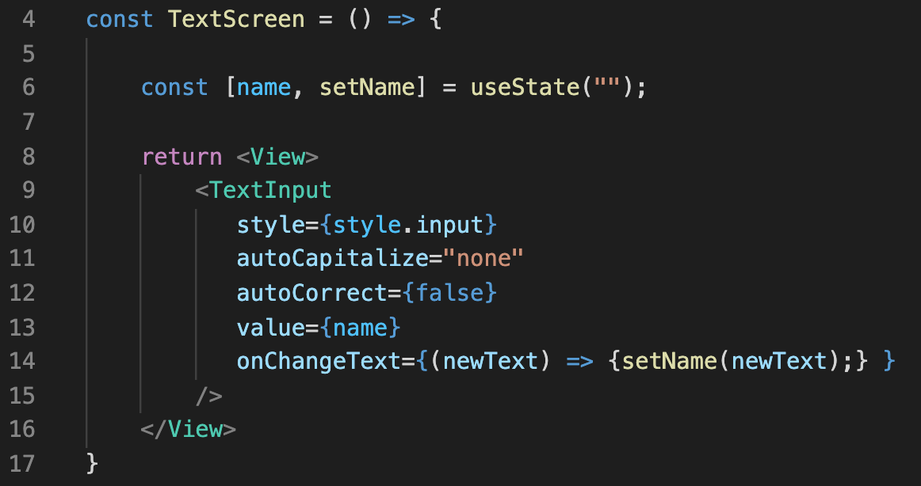
Text and State
And then the body can just be a call to the setter for our state!
Where we’ll just pass in ‘newText’, i.e., we’ll set the value of the state to be whatever is currently in the TextInput.

Slide 59
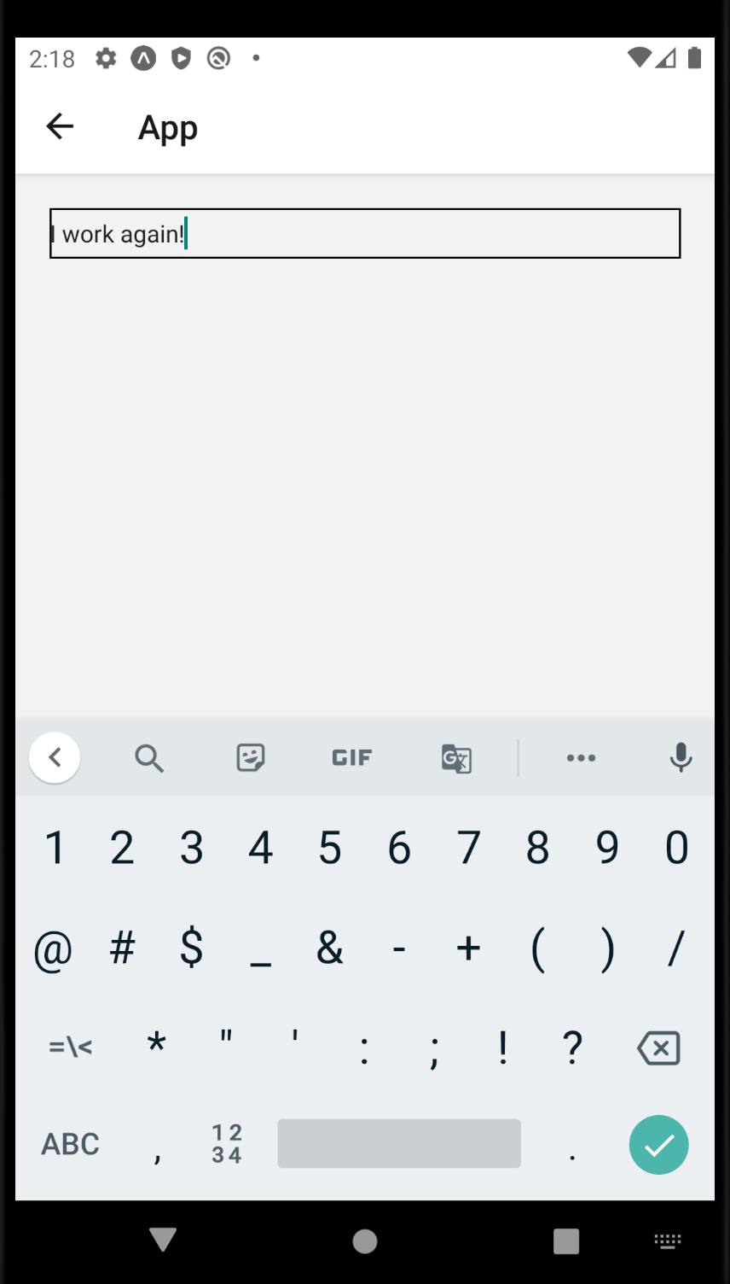
Text and State
And with that, we have the capacity to enter text into our TextInput again!
Each time we push a key, it calls our onChangeText callback function.
It receives as an argument the current text of the TextInput.
Which we then pass into our setter function.
Which in turn re-renders the screen!

Slide 60
Text and State
And the whole reason why we did that, is that now the state “lives” in the parent component!
The parent doesn’t have to reach in and inspect the child.
Let’s take advantage of that! Let’s use this state now in another child component!

Slide 61
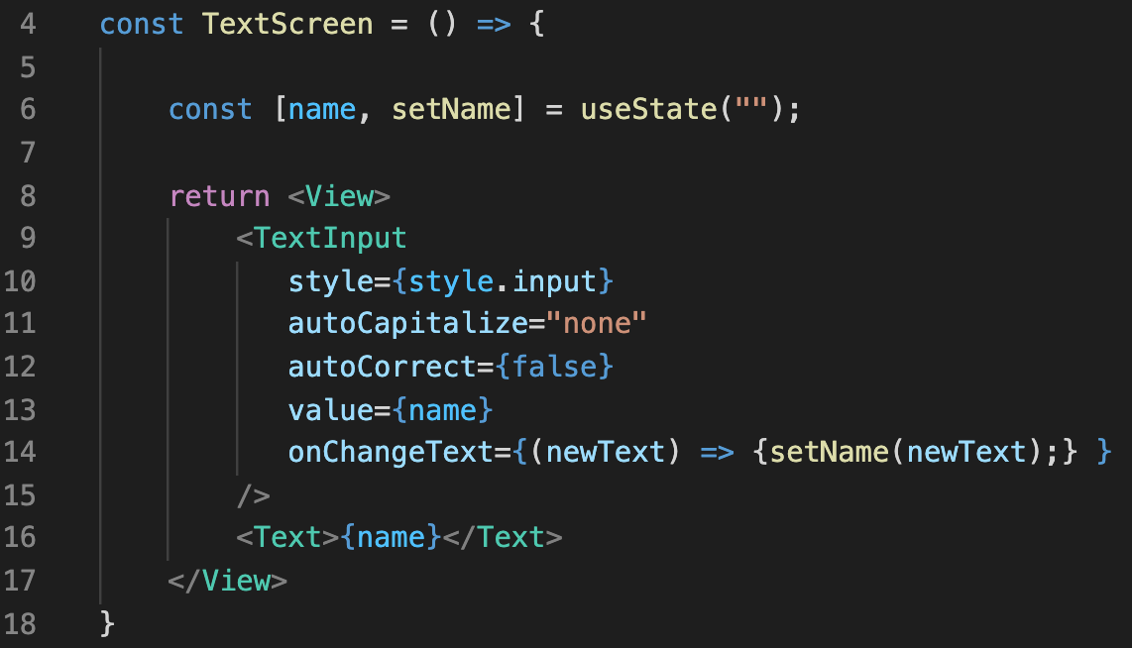
Text and State
At this point, it’s super simple!
We’ll just add another Text component to our TextScreen!
And we’ll have its content be our piece of state!

Slide 62
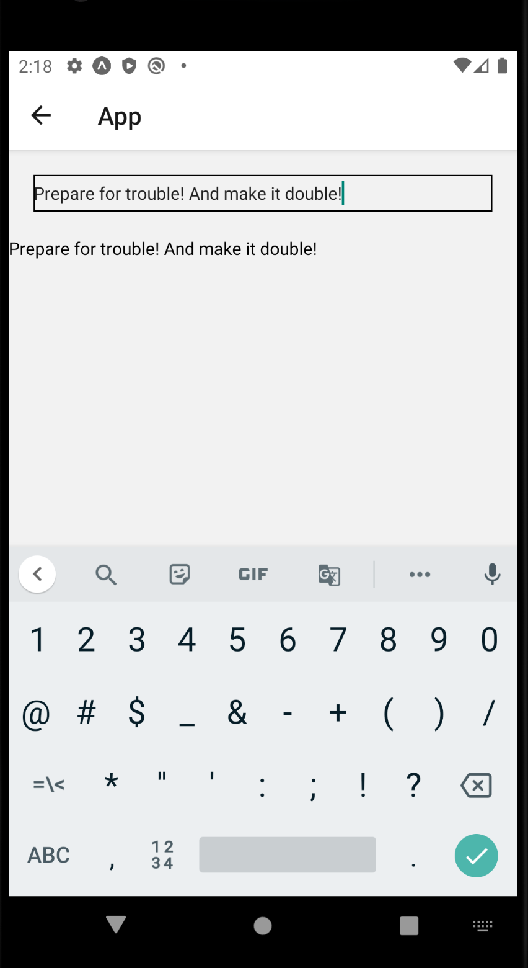
Text and State
When we call the setter, we update the value of our piece of state, and rerender the screen!
Showing the new value of that state everywhere we specify it!
Neat!

Slide 63
Text and State
When we call the setter, we update the value of our piece of state, and rerender the screen!
Showing the new value of that state everywhere we specify it!
Neat!

Slide 64
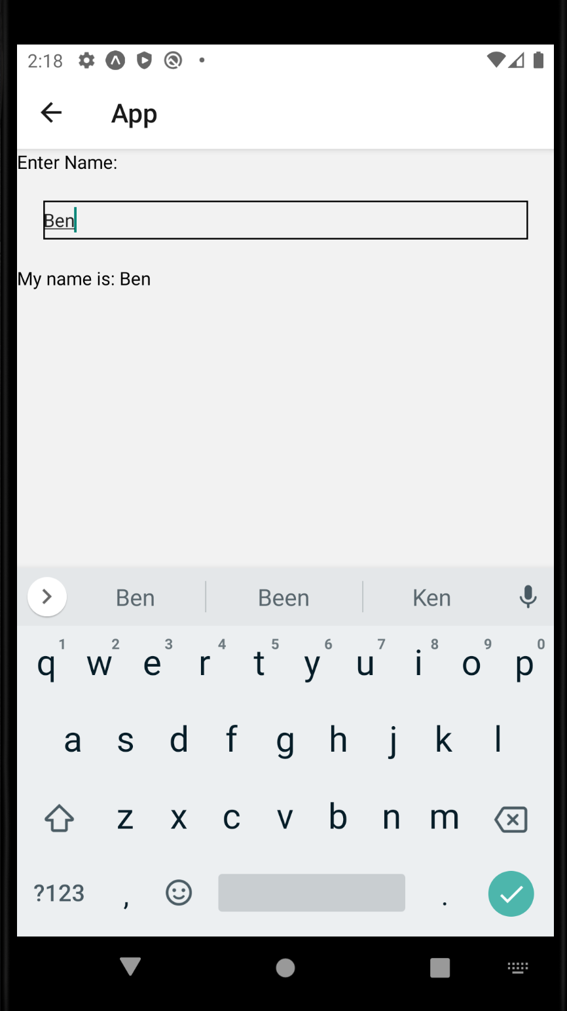
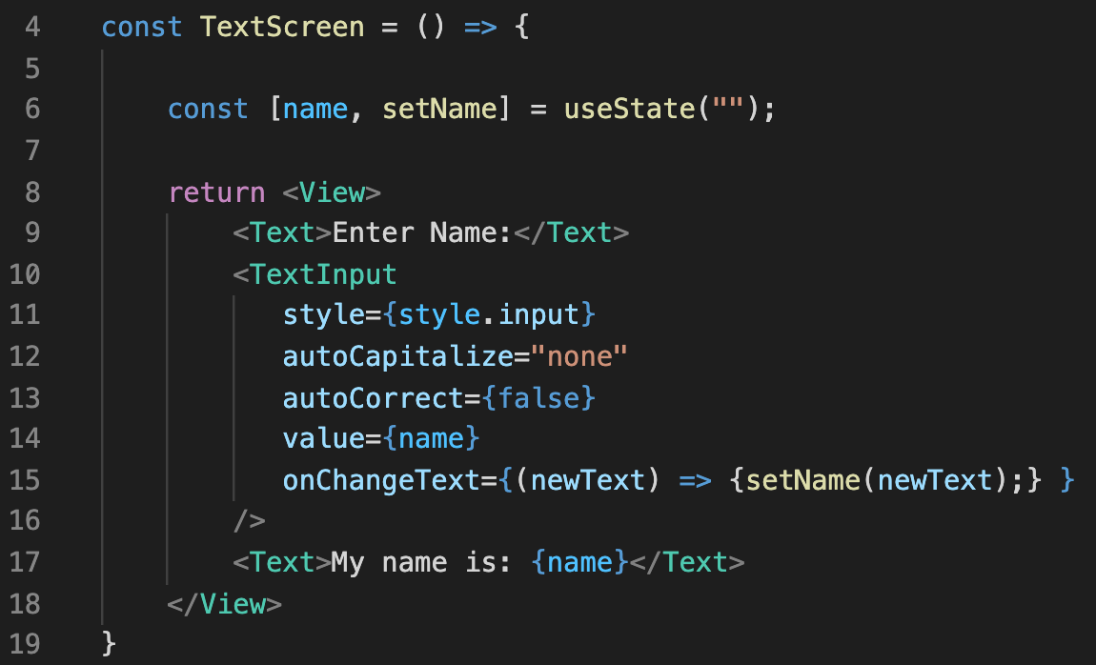
Text and State
Technically the mock up was for entering names, so we can add that in easily enough.

Slide 65
Text and State
So, neat, that wasn’t so bad!
We now have the capacity to allow the user to enter text!
And for the state that corresponds to that be stored in the parent component!

Slide 66
Today’s Agenda
Today’s Plan
The TextInput Component
Text and State
Conditional JSX

Slide 67
Conditional JSX
Enter Your Name:
So, let’s make one last quick adjustment to this.
Let’s say that we wanted to let the user type in a username.
And that username had to be at least 5 characters long.
If it is less, there should be a message that shows up.
Name must be at least 5 characters long!

Slide 68
Conditional JSX
Enter Your Name:
My_Awesome_Name
And so that message goes away if you write a long thing.
How would you do that?

Slide 69
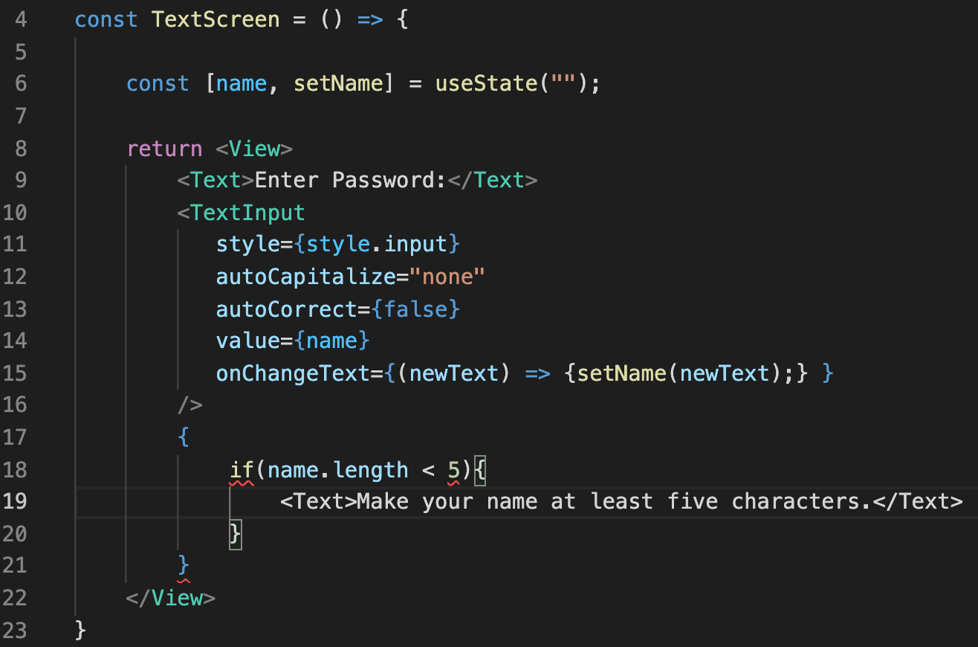

Conditional JSX
Perhaps the gut answer is to use an if statement.
But sadly, you aren’t allowed to use if statements inside of JSX.

Slide 70
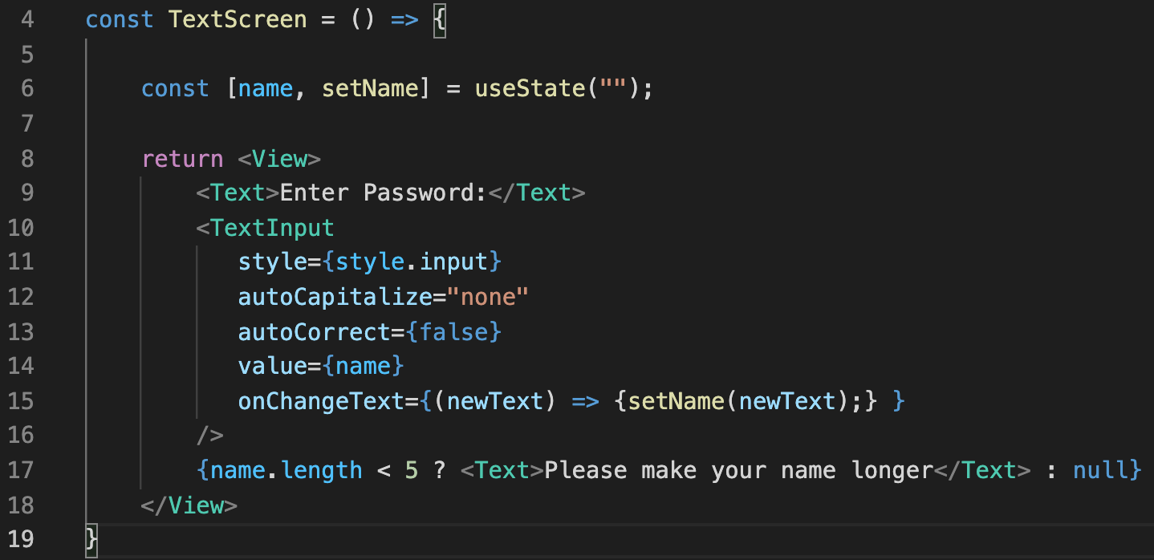
Conditional JSX
BUT, as it turns out, you ARE allowed to use the conditional operator!

Slide 71
Conditional JSX
You can have JavaScript statements inside of JSX if you put it inside of these curly braces.

Slide 72
Conditional JSX
And null is a valid thing to just write here in JSX.
So basically:
if name is less than 5, add a Text component
Otherwise, do nothing!

Slide 73
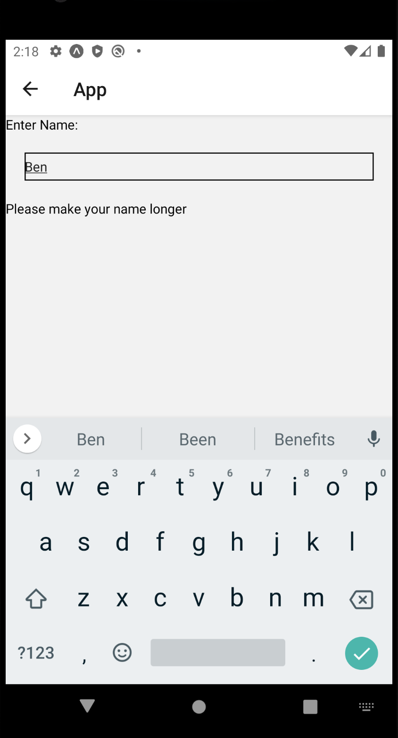
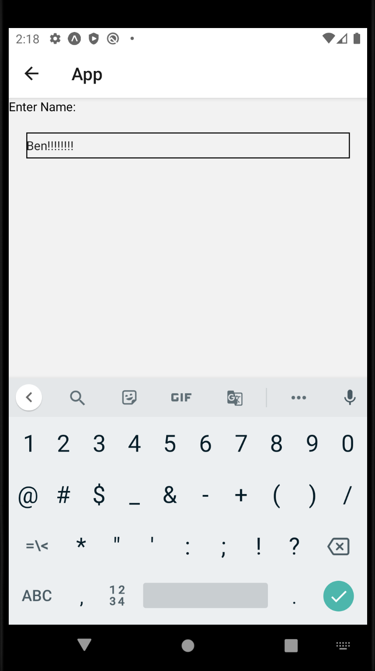
Conditional JSX
And now, if the length of our name string is too short, it will display that Text component.
Otherwise, it won’t!

Slide 74
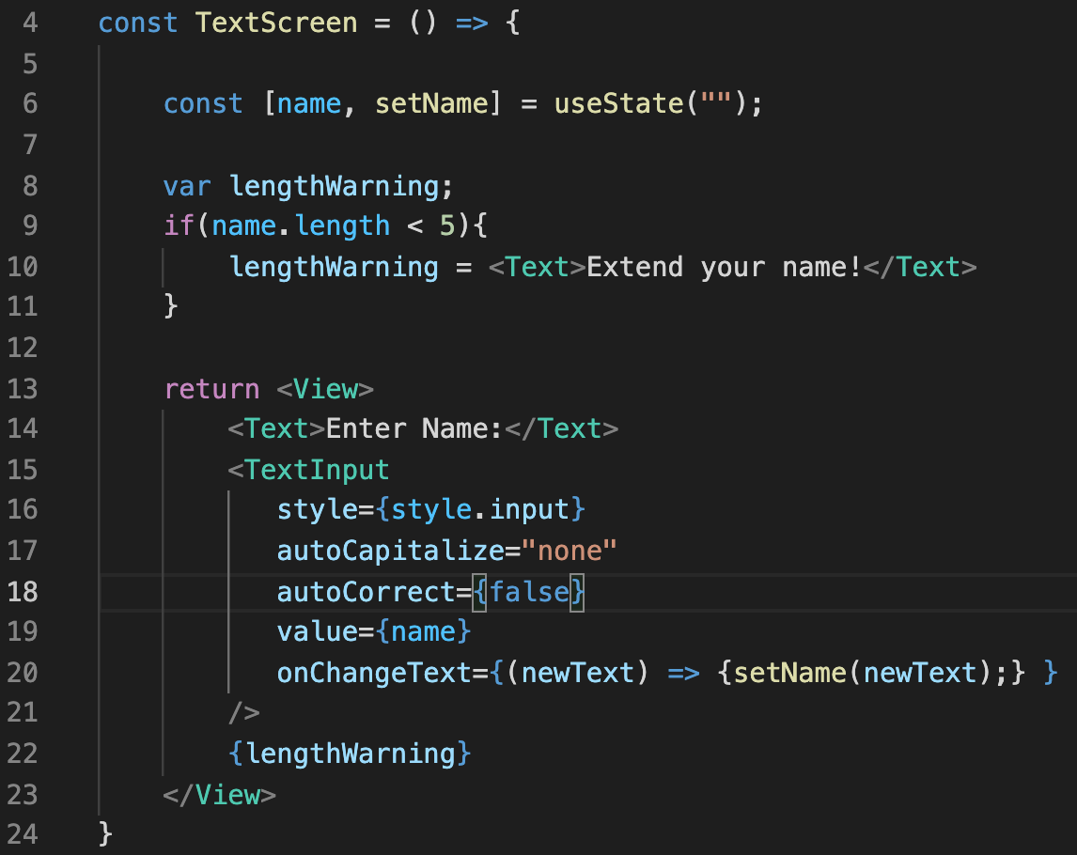
Conditional JSX
An alternative, for them that likes if statements!
You create a variable outside the JSX that you are returning…

Slide 75
Conditional JSX
And you do whatever conditional logic you need to do out there, to fill it with the appropriate JSX.
So here, we store a text component inside of our variable
But only if length < 5

Slide 76
Conditional JSX
And then we can just use it!
Either it has a Text component, or it has nothing!
Either way, no crash!

